Slide 1
Chapter 18 – Parallel Port
CSE 3442
Tom Rethard

Slide 2
Centronics Interface
De Facto standard for parallel printer connections
Also called “Epson FX-100” standard
  FX-100 was an early printer targeted to PCs
Uses 36 pins

Slide 3
Centronics Pin Groupings
  Data lines
  Printer status signals
  Printer control signals
    Tell printer what to do
  Ground signals
    Individual ground return for each data line
    Individual ground return for some status and control lines

Slide 4
Centronics
Interface
Specs

Slide 5
Data Lines
Pins 20-28 on Centronics
Pins 2-7 on DB-25 Parallel Connector

Slide 6
Status Signals
PE – paper end on pin 12
BUSY – on pin 11
ERROR on pin 32
SLCT – selected on pin 13
ACKNLG – acknowledge receipt on pin 10

Slide 7
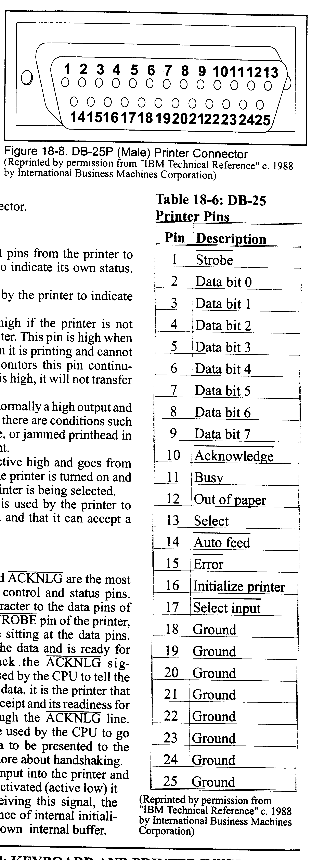
DB25P Connector

Slide 8
Control Signals
STROBE – data ready for printer on pin 1
  Used with ACKNLG to sync transfer
INIT – reset printer on pin 31
AUTO FEED XT – control auto line feed on pin 14. Usually set in printer dip switch
SLCT IN – controls data entry on pin 36

Slide 9
Sequence
Computer checks for printer BUSY high
Computer write byte of data to data lines and waits at least 0.5μs.
Computer takes the STROBE pin low
STROBE stays low for at least 0.5μs
Data on data pins for at least 0.5ms after STROBE resets
Printer sets BUSY high
Printer retrieves the byte
Printer sets ACKNLG low for 5ms
Printer sets BUSY low

Slide 10
Interfacing on the PC
POST
  Checks for printer connection
  Writes base I/O port address to BIOS data area 0040:0008 – 0040:000FH (similar to com ports)
3 ports used for printer
  I/O port for data
  I/O port for status
  I/O port for control

Slide 11
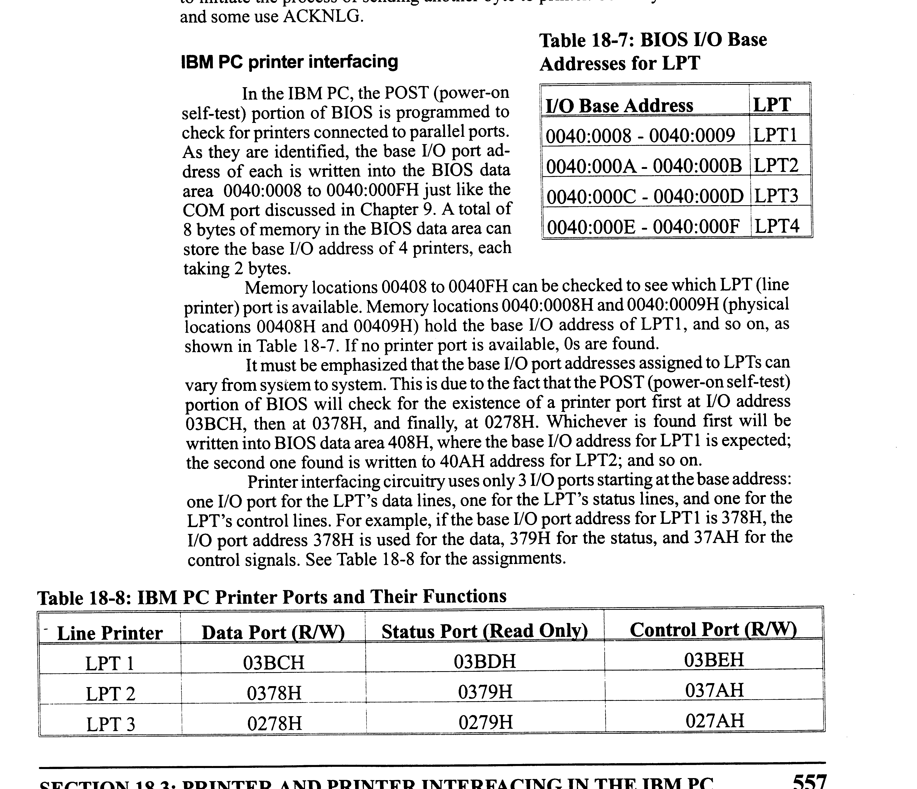
I/O Addresses and Ports

Slide 12
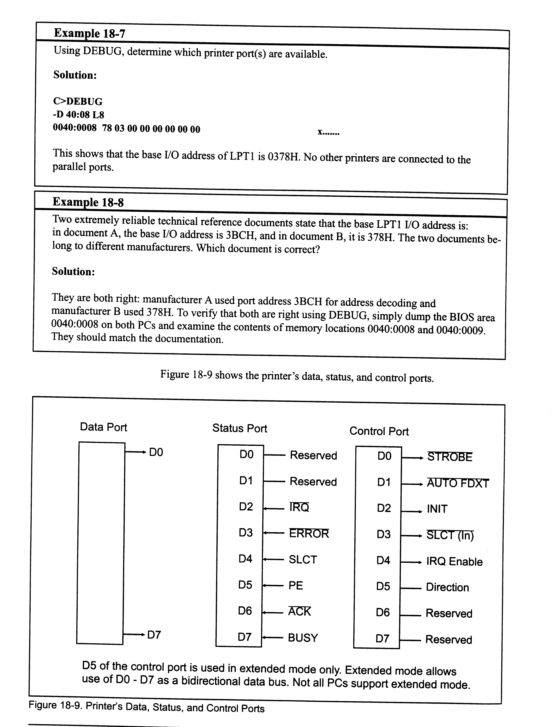
Port Details

Slide 13
Example 18-7

Slide 14
Example 18-8

Slide 15
BIOS INT 17H Services
Print a character
  AH=0
  DX=LPT number (0,1,2)
  AL=data byte
  Status at return in AH
    7 – 1 = busy, 0 = not busy
    6 – 1 = ACK
    5 – 1 = out of paper
    4 – 1 = printer selected
    3 – 1 = I/O error
    2,1 – not used
    0 – 1=printer timeout

Slide 16
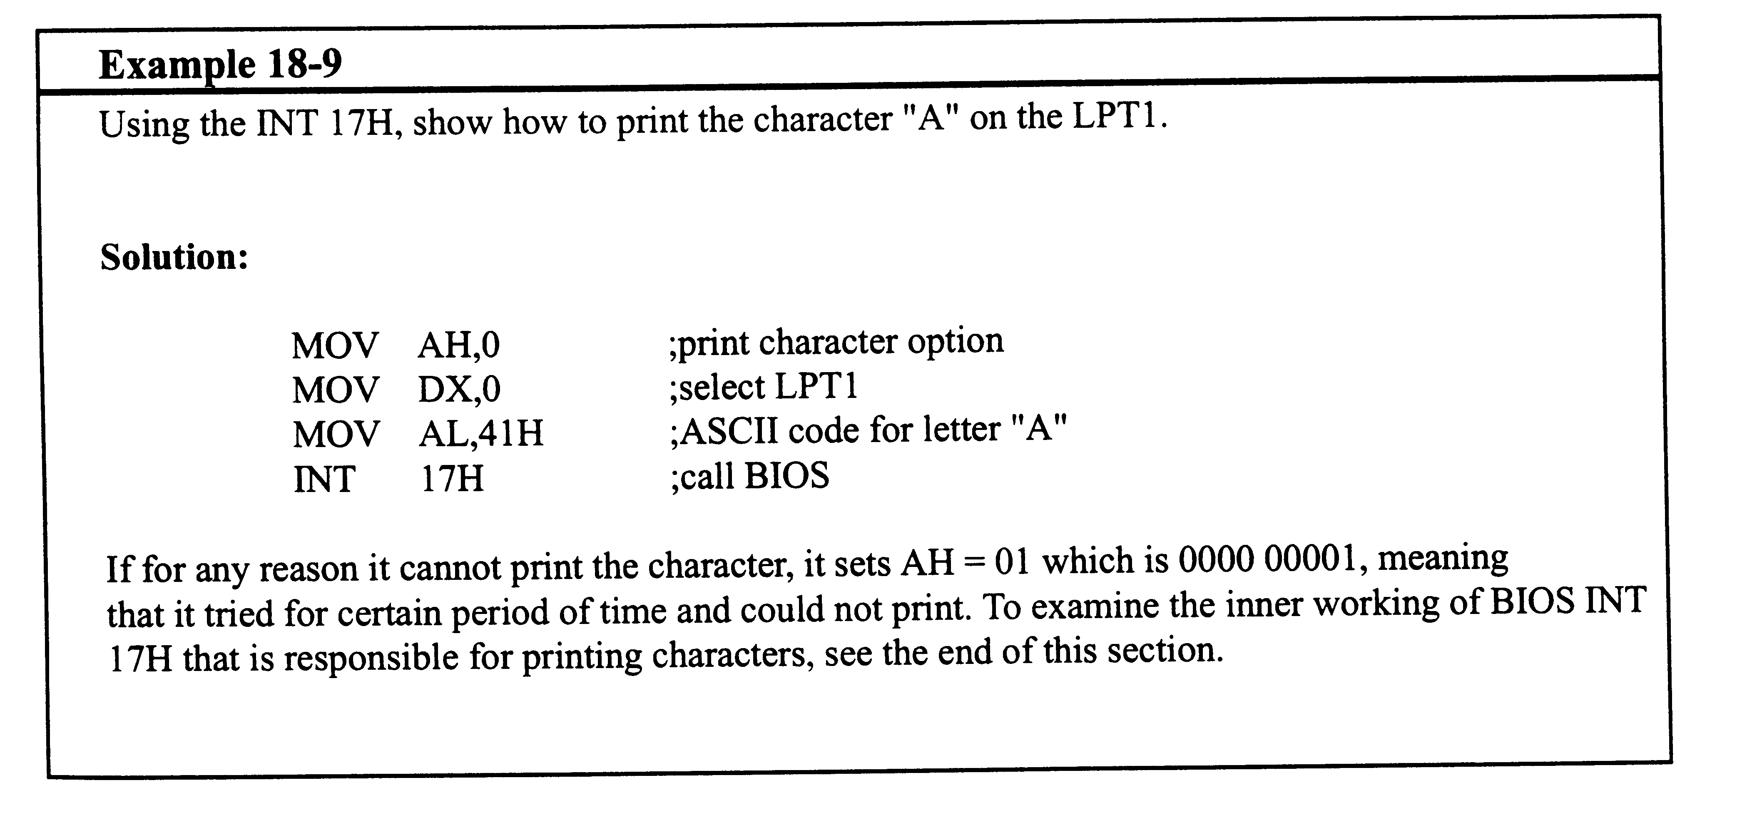
Example 18-9

Slide 17
BIOS INT 17H Services
Initialize printer port
  AH = 1
  DX = printer number

Slide 18
BIOS INT 17H Services
Get printer port status
  AH = 2
  DX = printer number
  Status as return in AH
    Same as for print and initialize

Slide 19
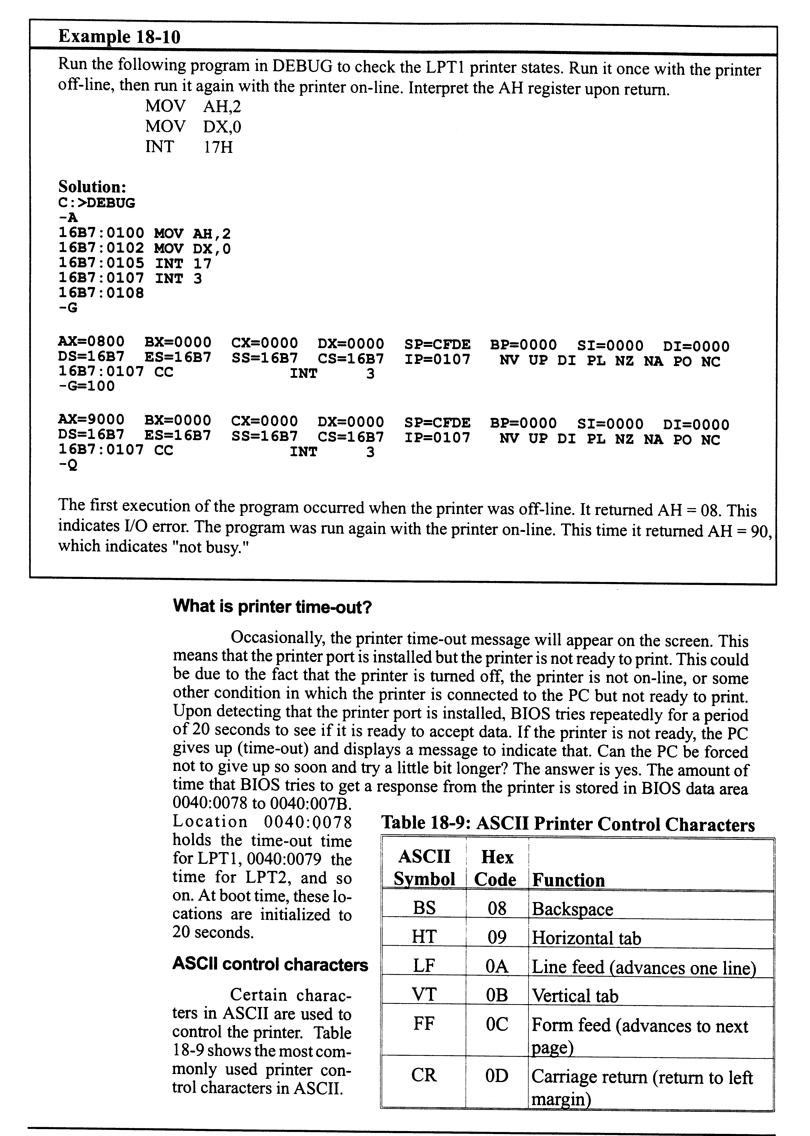
Example 18-10

Slide 20
ASCII Print Control Characters

Slide 21
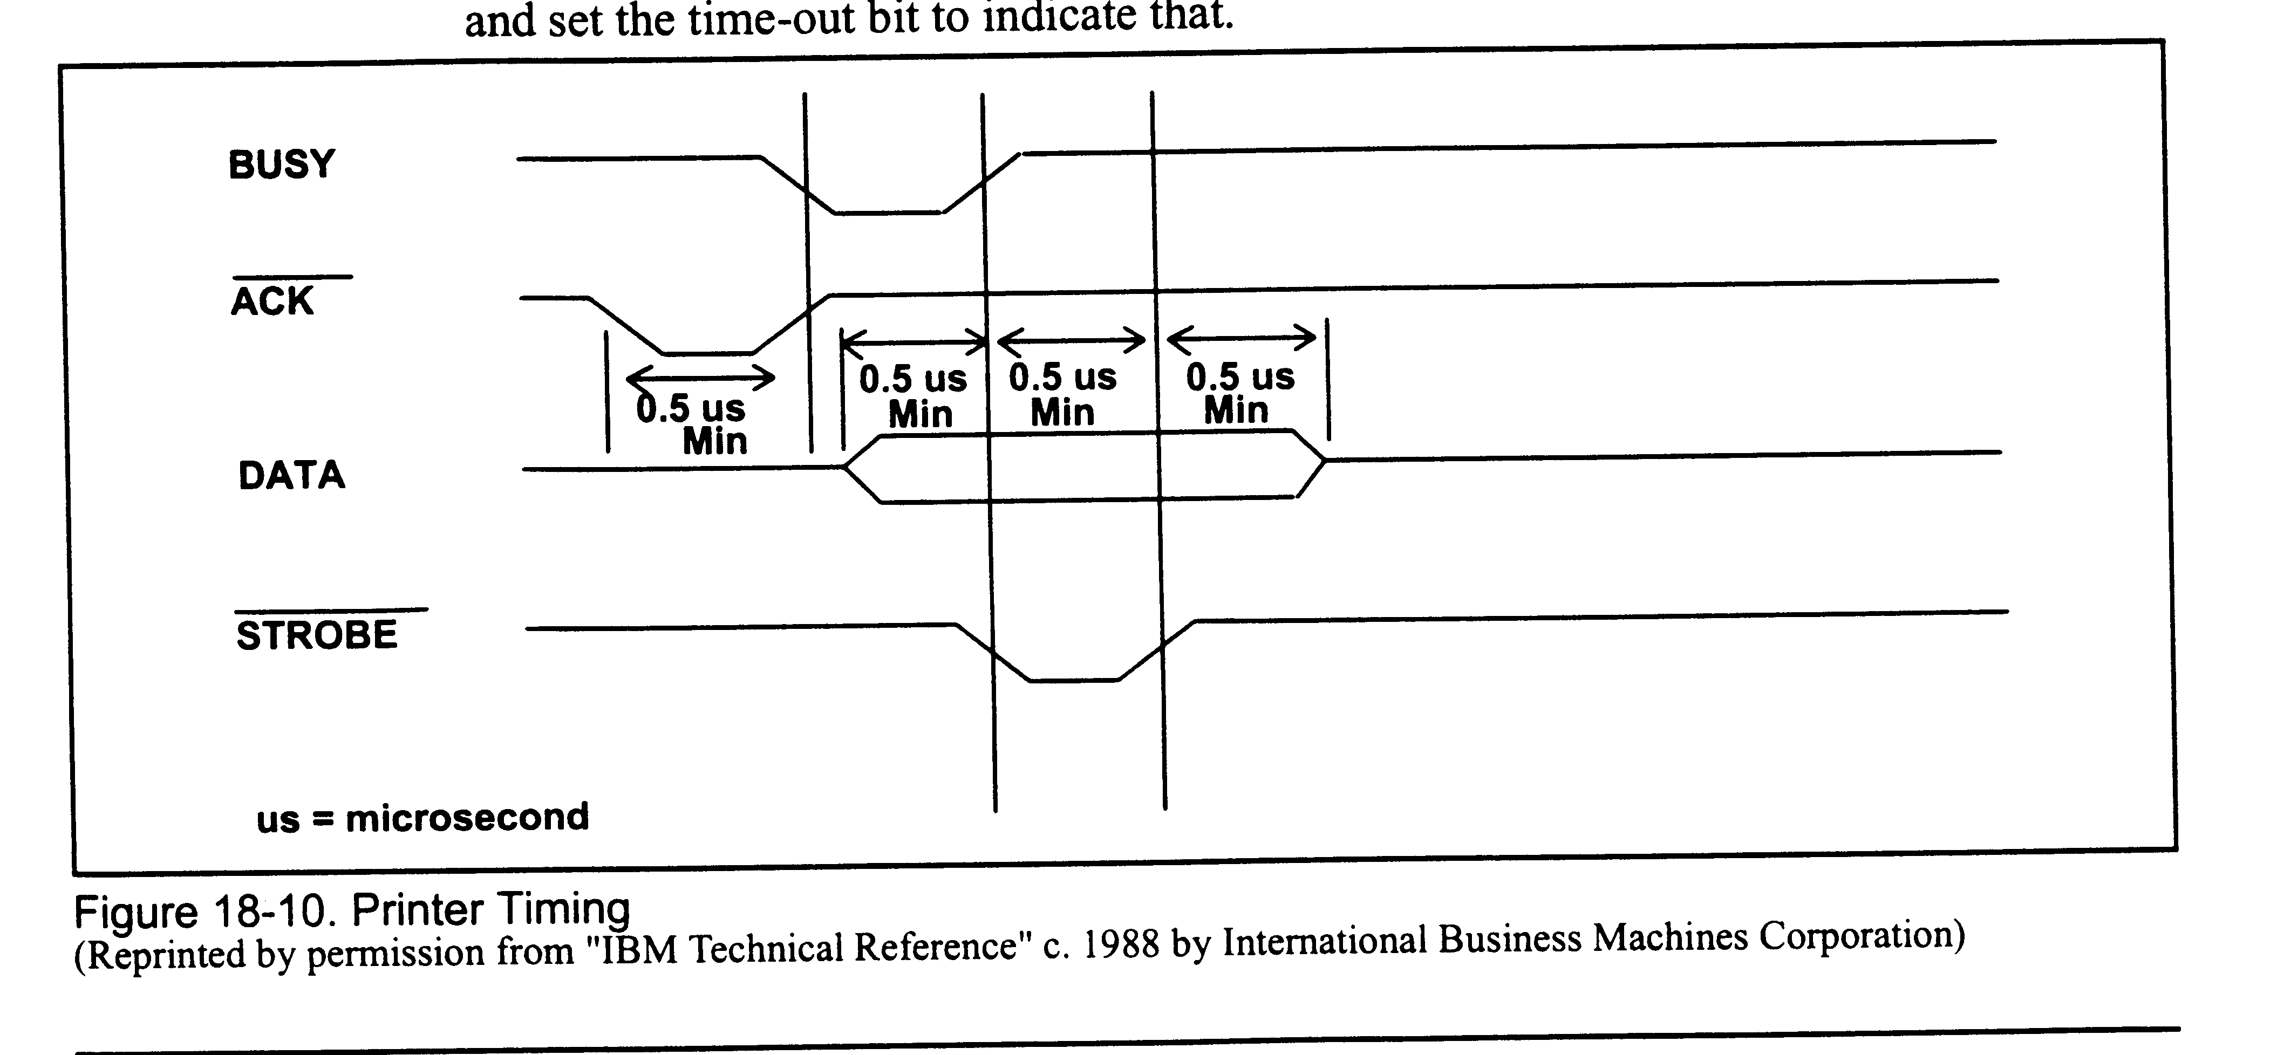
Printer Timing

Slide 22
Bidirectional Support
SPP
  Standard parallel port
  Unidirectional
PS/2
  Could be changed to bidirectional
  Out of use

Slide 23
Bidirectional Support
EPP
  Enhanced parallel port
  Similar to PS/2 but faster
  Handshaking done in hardware instead of software
  Added new registers to the I/O port address space (up to 7)

Slide 24
Bidirectional Support
ECP
  Extended capability port
  EPP + DMA
  Data compression capability
  Designed for laser printers and scanners
  HP & Microsoft
  Can support all previous types

Slide 25
Output to LPT Port
Can use a printer port to send data to other devices, such as LCDs and stepper motors.
MUST buffer output
  Use 74LS244

Slide 26
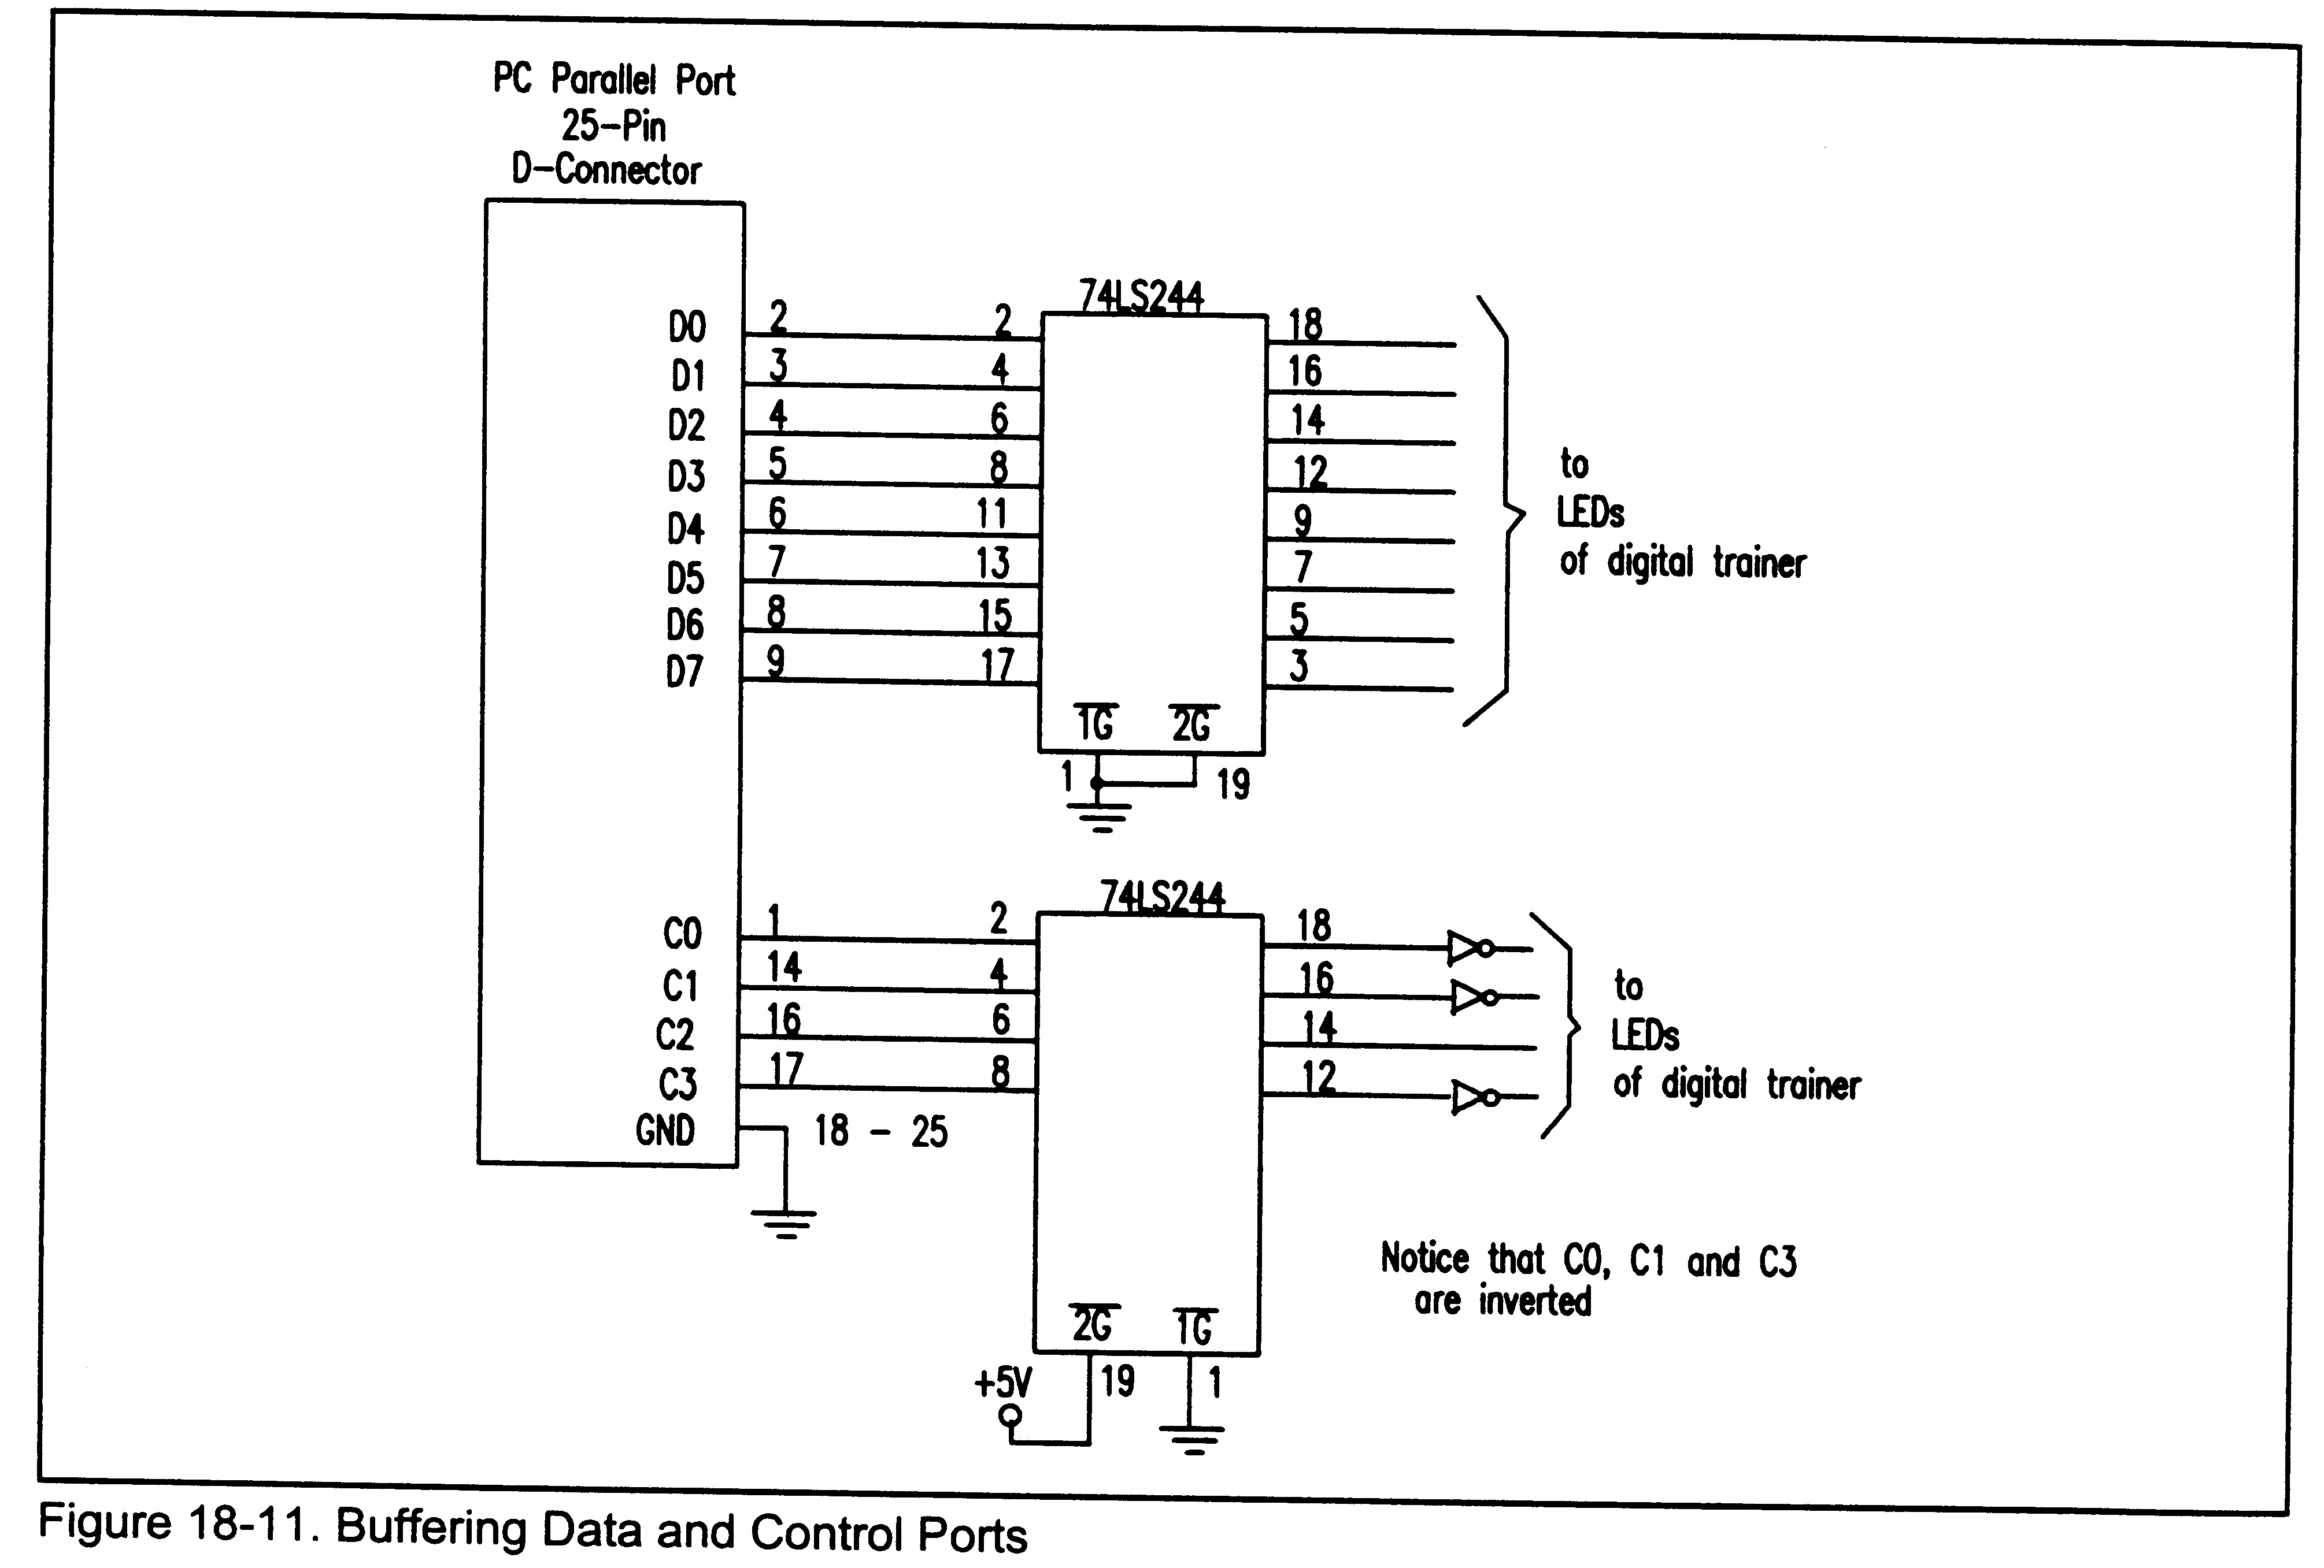
Buffering Ports

Slide 27
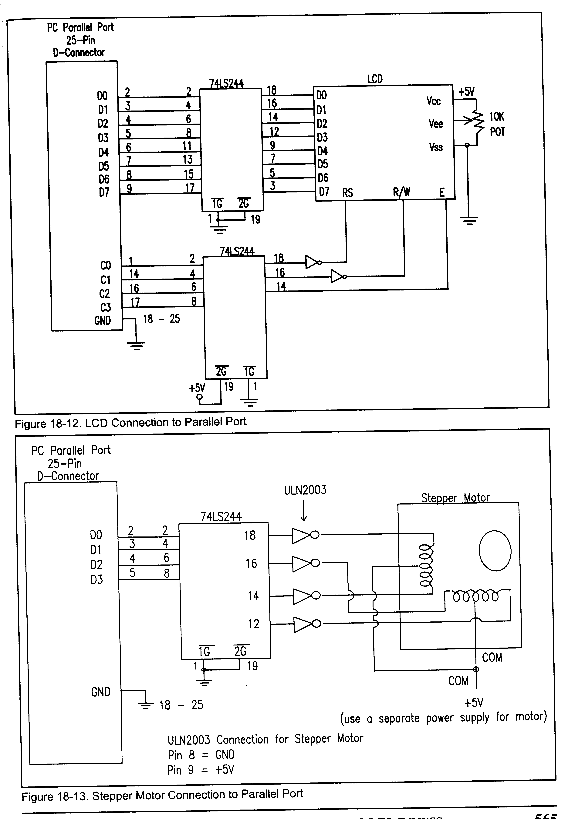
LCDs on Parallel Port

Slide 28
LCD Connection
Cannot check busy flag
Insert a time delay between command and data

Slide 29
Stepper Motor Connection

Slide 30
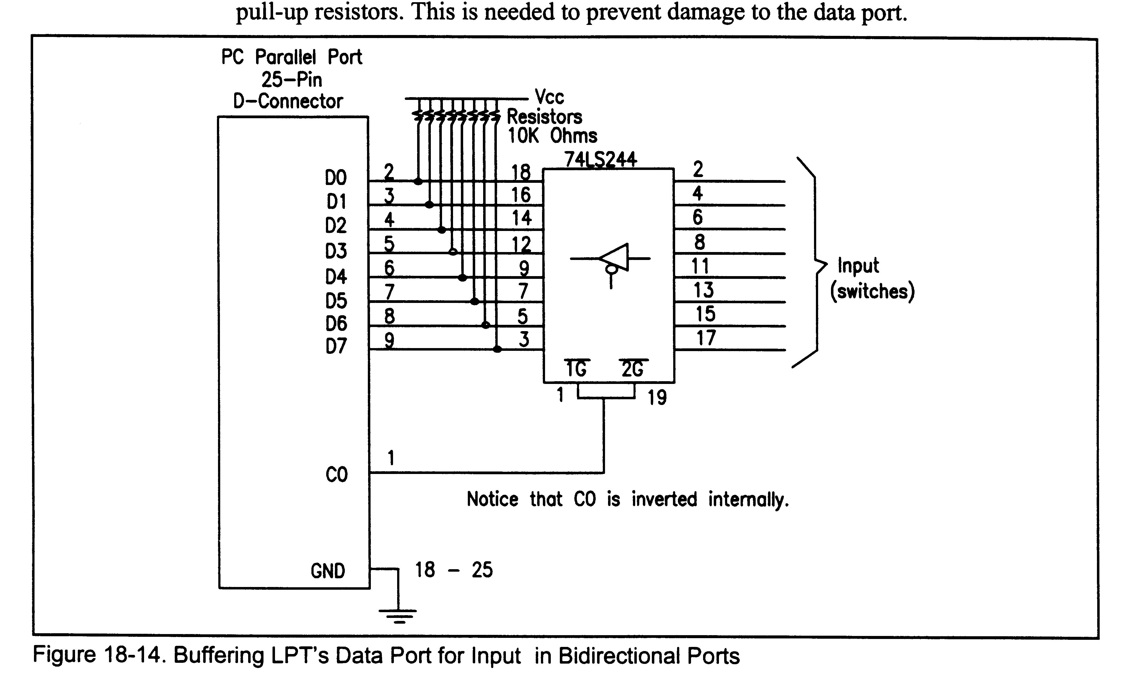
Buffering - Bidirectional
Notes:
Not the 10KOhm pull-up resistors to protect the port

